Slide 1
Learning Strategy of the Week: Learning Toolbox

Slide 2
Learning Strategy of the Week: My Learning Toolbox
There are so many startegies/approaches that can help you learn. Think of strategies like tools in a tool box – pick the right one for you to do the particular learning job

Slide 3
Learning Strategy of the Week: My Learning Toolbox
For every job, there is the right tool…

Slide 4
Learning Strategy of the Week: My Learning Toolbox
Some tools/strategies we have consolidated/made clear this year:

Slide 5
Learning Strategy of the Week: My Learning Toolbox
Some tools/strategies we have consolidated/made clear this year:

Slide 6
Learning Strategy of the Week: My Learning Toolbox
Some tools/strategies we have consolidated/made clear this year:

Slide 7
Learning Strategy of the Week: My Learning Toolbox: Strategies
Why use a strategy?
Sometimes, learning seems overwhelming. Sometimes, we don’t know where to start or what to do when we want to learn something or when we “stuck”. Strategies help us find a way to make learning work for us.
You still need to work hard but strategies can help make the time you put in more effective.
They help us to train our minds how to learn and how to go deeper with our understanding.

Slide 8
Learning Strategy of the Week: My Learning Toolbox Some more strategies to help your learning…

Slide 9
Learning Strategy of the Week: My Learning Toolbox:

Slide 10
Learning Strategy of the Week: Learning Toolbox: Blue Sky Thinking
What is it:
This strategy asks you to think “outside the box”, where every idea is considered and you are only limited by you imagination (lateral thinking)
This strategy is a means of kick-starting your imagination and pushes you to provide a variety of options or ideas.
Your ideas can be big and limitless like the sky!

Slide 11
Learning Strategy of the Week: Learning Toolbox: Blue Sky Thinking

Slide 12
Learning Strategy of the Week: Learning Toolbox: Blue Sky Thinking
How to use it:
Think about a problem/topic you want to discuss.
Brainstorm/note every idea that comes into your head - be as creative as you can be, the sky is the limit.
Discuss your answers and think about the answers of others
Decide on your viewpoint

Slide 13
Learning Strategy of the Week: Learning Toolbox: Blue Sky Thinking

Slide 14
Learning Strategy of the Week: Learning Toolbox: Blue Sky Thinking
Great for:
Seeing all the possibilities
Listening to others
Working with others
Thinking out problems
Working through difficult ideas/concepts
Seeing the whole picture
No answer is wrong – it is all about the process!

Slide 15
Learning Strategy of the Week: My Learning Toolbox:

Slide 16
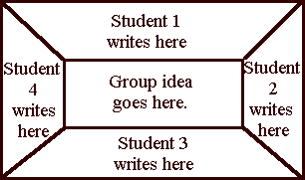
Learning Strategy of the Week: Learning Toolbox: Placemat
What is it:
This helps you learn how to build on ideas, your own or those of others, and combine common thoughts into a combined single statement.
It is a mat with different sections that are filled in on different sections of a topic or by different people. All the sections are brought together into one main idea.
It can be done in a group or on your own

Slide 17
Learning Strategy of the Week: Learning Toolbox: Placemat
How to use it:
write down answers to the question in the separate section on the paper
If working in a group, share your idea with others and discuss each other’s opinions and reach a decision on the group answer
Place the most important point agreed by the group in the centre

Slide 18
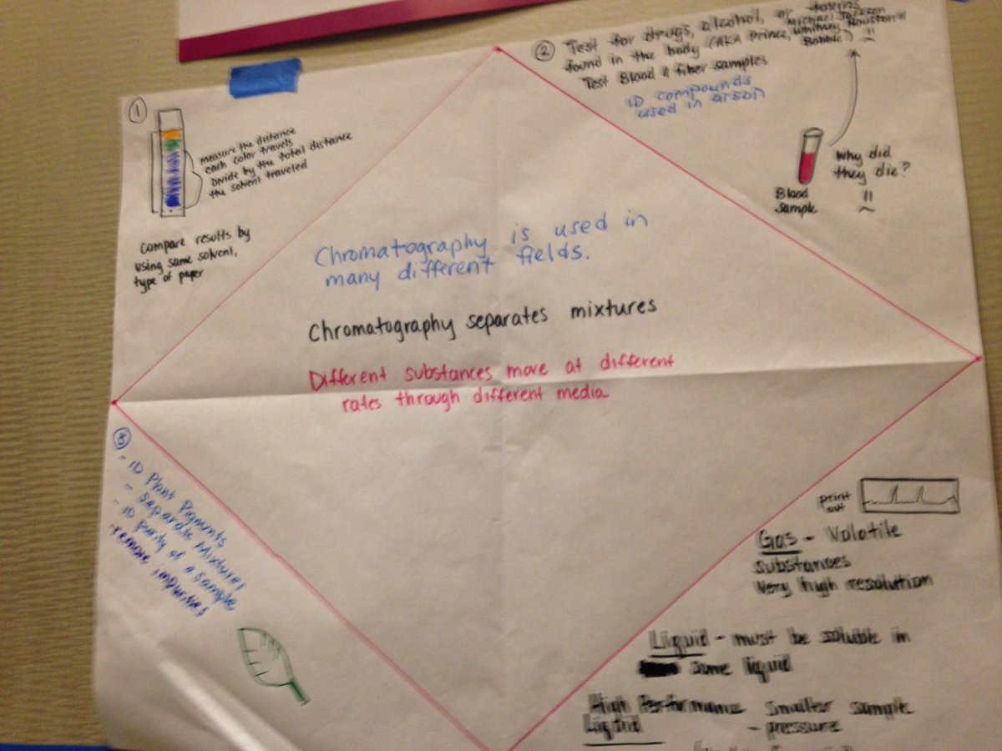
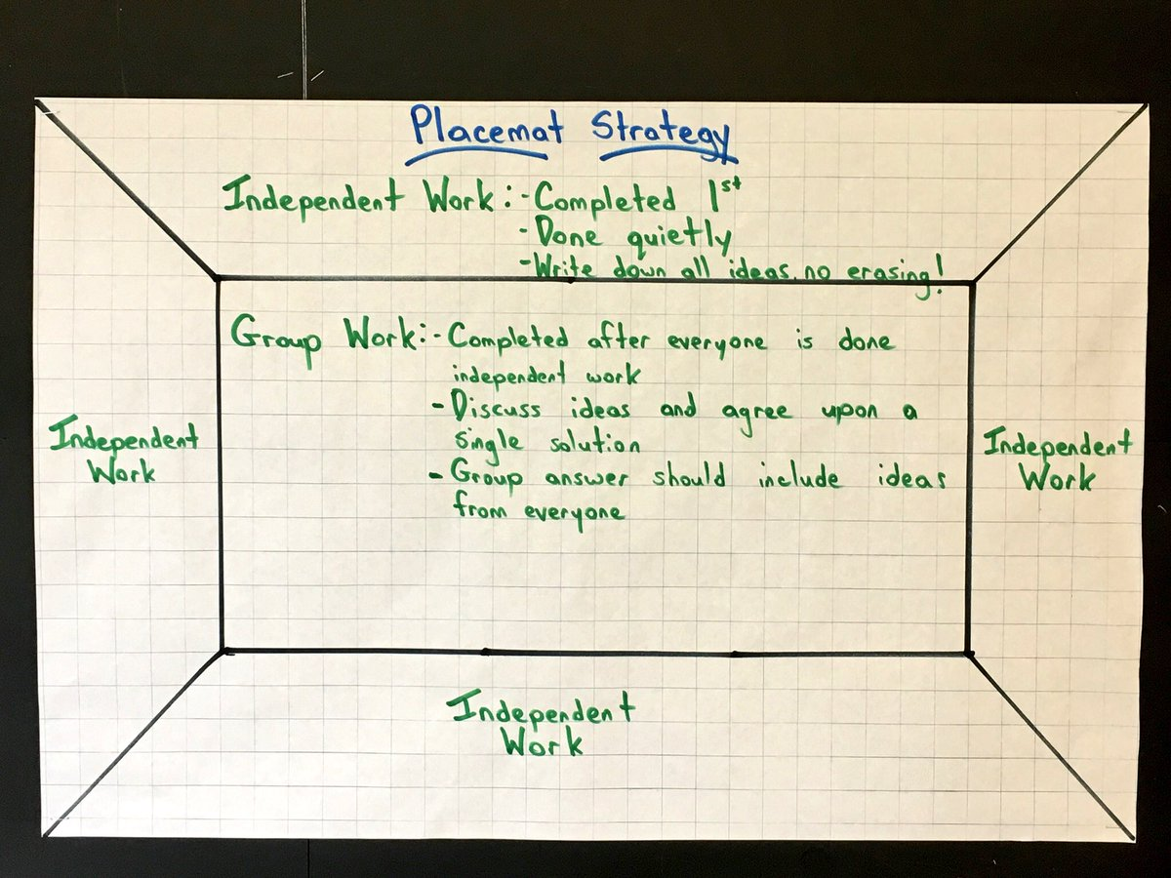
Learning Strategy of the Week: Learning Toolbox: Placemat
Great for:
Helping you to understand a topic/question
Coming to one decision
Seeing all the possibilities
Listening to & working with others
Thinking out problems
Working through difficult ideas/concepts

Slide 19
Learning Strategy of the Week: Learning Toolbox: Placemat
– some templates

Slide 20
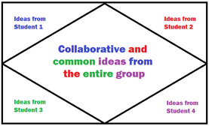
Learning Strategy of the Week: Learning Toolbox: Placemat
– some templates

Slide 21
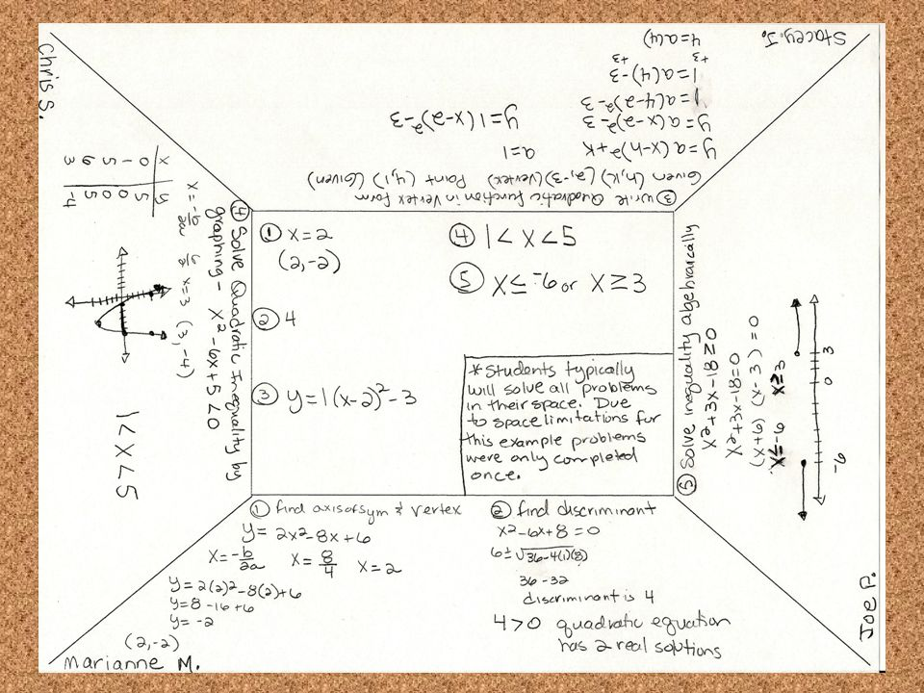
Learning Strategy of the Week: Learning Toolbox: Placemat

Slide 22
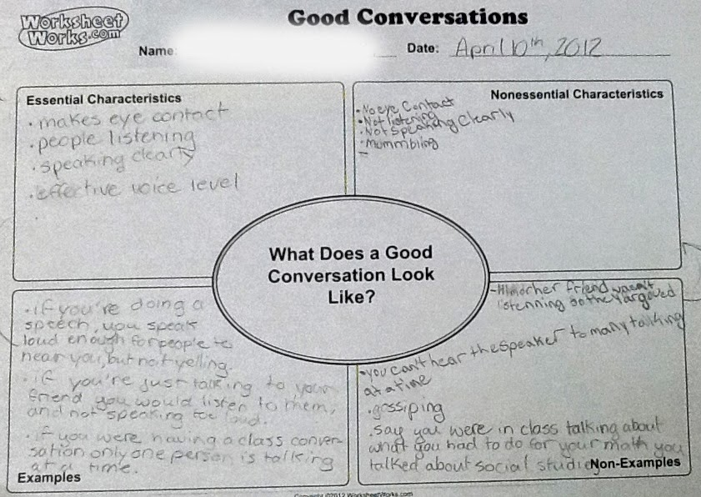
Learning Strategy of the Week: Learning Toolbox: Placemat

Slide 23
Learning Strategy of the Week: My Learning Toolbox:

Slide 24
Learning Strategy of the Week: Learning Toolbox: Magenta Principles
What is it:
This approach wants you to use the information you learn/gain in new/different ways
By trying to use the information in new ways, you learn more effectively
The idea was created by educator Mike Hughes

Slide 25
Learning Strategy of the Week: Learning Toolbox: Magenta Principles
The main idea:
Learning is a consequence of thinking – therefore you have to think
Language is central to thinking – therefore you have to talk/communicate
Learning is an active process – therefore you need to use your learning

Slide 26
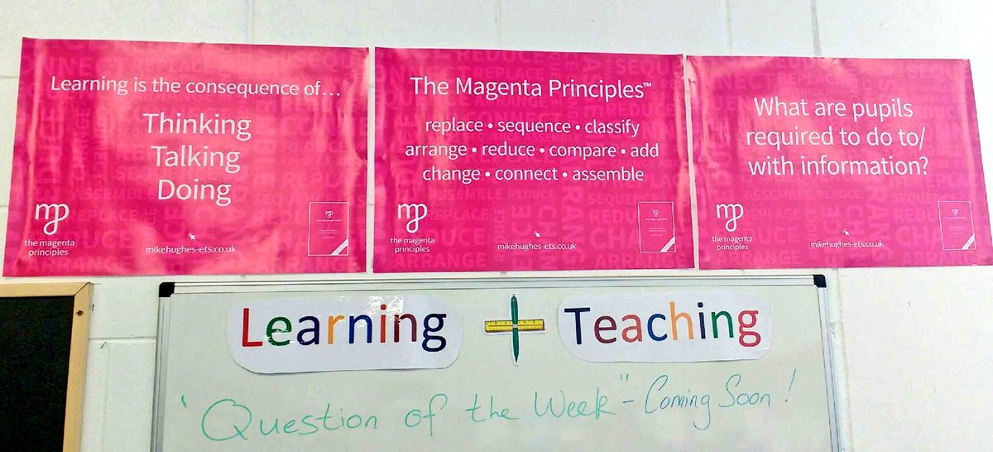
Learning Strategy of the Week: Learning Toolbox: Magenta Principles
How to use it:
After learning something, try to use the information e.g. change it (make it into a story/poem/rap), act it out (create a drama) etc.
The key thing is to change and use the information and learn through action

Slide 27
Learning Strategy of the Week: Learning Toolbox: Magenta Principles

Slide 28
Learning Strategy of the Week: Learning Toolbox: Magenta Principles
The ways you can use what you have learnt…

Slide 29
Learning Strategy of the Week: Learning Toolbox: Magenta Principles
Great for:
Seeing all the possibilities
Making you thinking about your learning in new ways
Making learning fun and interesting
Working through difficult ideas/concepts

Slide 30
Learning Strategy of the Week: Learning Toolbox: Magenta Principles
The aim is to create active, motivated, independent learners that work hard and are flexible

Slide 31
Learning Strategy of the Week: My Learning Toolbox:

Slide 32
Learning Strategy of the Week: Learning Toolbox: Think Time
What is it:
This approach wants you to take some time before answering and to wait when you ask another person a question to give them time
Think time is important as when we reflect on our answers, we can create more effective answers
Think time is good for our wellbeing also as it allows us space to consider and time to respond

Slide 33
Learning Strategy of the Week: Learning Toolbox: Think Time
How to use it:
When answering a questions, take some time before answering:
Think about the question – what are the critical verbs/what exactly are you being asked?
Think about your answer – are you really answering the question asked?
Could you add more detail/examples?
This is like the process of drafting and redrafting

Slide 34
Learning Strategy of the Week: Learning Toolbox: Think Time
Great for:
Giving you a pause to consider
Wellbeing – take your time
A better, more effective response – by taking a few moments longer to think, you can give a much deeper answer that really addresses the question you were asked

Slide 35
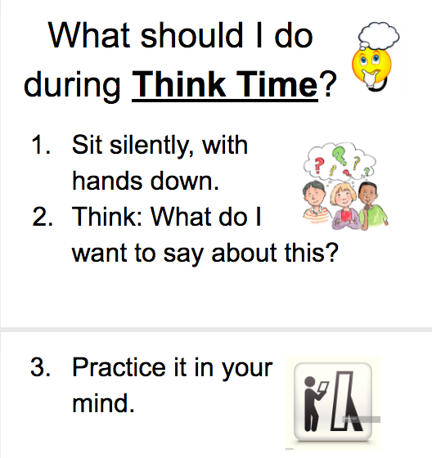
Learning Strategy of the Week: Learning Toolbox: Think Time

Slide 36
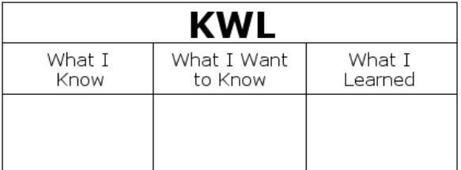
Learning Strategy of the Week: My Learning Toolbox:

Slide 37
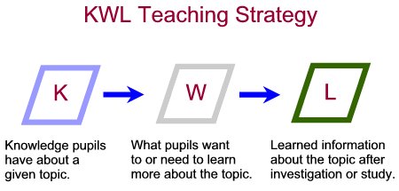
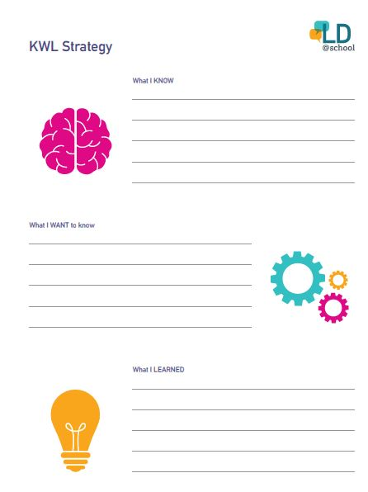
Learning Strategy of the Week: Learning Toolbox: KWL
What is it:
This approach wants you to reflect on what you know about a topic, what you would like to know and afterwards, what you have learnt
It is one way you can be clear on what you know
It can be used with a tweet board and the reflection arrow

Slide 38
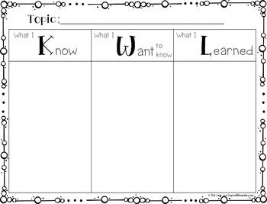
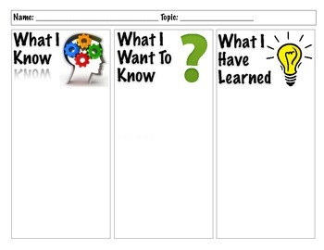
Learning Strategy of the Week: Learning Toolbox: KWL
How to use it:
Draw a grid with three columns
In the 1st column, write in all you know about a topic, your prior knowledge
In the 2nd column, write down what you would like to know, the questions you have, what makes you curious…
In the 3rd column, write down what you have learnt. You can link to column 1 & 2

Slide 39
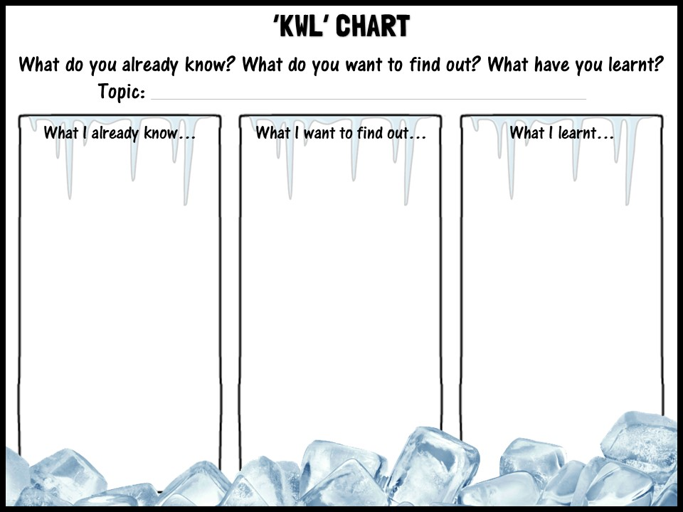
Learning Strategy of the Week: Learning Toolbox: KWL
Great for:
Establishing/understanding your learning
Tracking your learning
A revision tool, especially the last column
Linking to previous knowledge
Visual learners – graphic organiser
Use with brainstorming/mind map

Slide 40
Learning Strategy of the Week: Learning Toolbox: KWL
For senior students or if you want to deepen your learning, you can add columns to this graphic organiser for more detail…

Slide 41
Learning Strategy of the Week: Learning Toolbox: KWL
Remember all your strategies can be used with online distance learning and learning platforms. Be creative!

Slide 42
Learning Strategy of the Week: My Learning Toolbox The aim always is to deepen you understanding and thinking and so lead to deeper learning.

Slide 44
