Slide 1
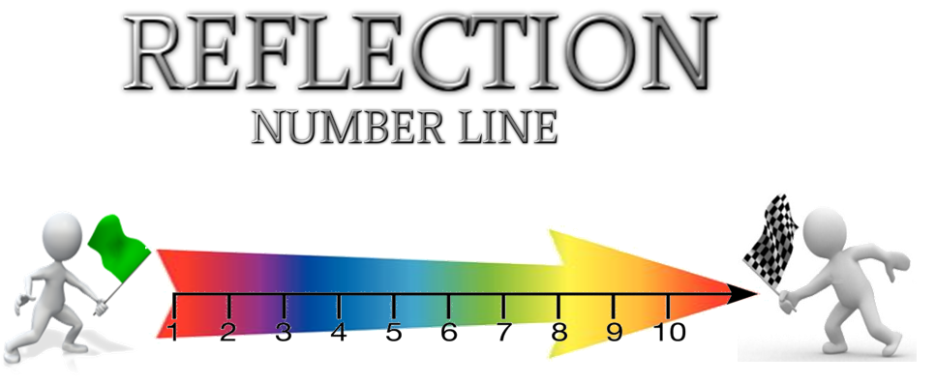
Learning Strategy of the Week: Reflection Arrow

Slide 2
Learning Strategy of the Week: Reflection Arrow
This strategy asks us to take some time to think about our learning; what we have done, where we are in our learning and what to do next.

Slide 3
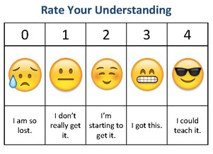
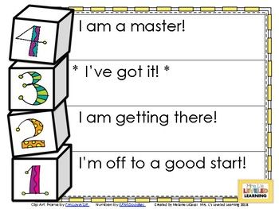
Learning Strategy of the Week: Reflection Arrow
Using a scale can help us to think about how comfortable we are with learning a topic…

Slide 4
Learning Strategy of the Week: Reflection Arrow
This strategy asks us to take some time to think about our learning; what we have done, where we are in our learning and what to do next.

Slide 5
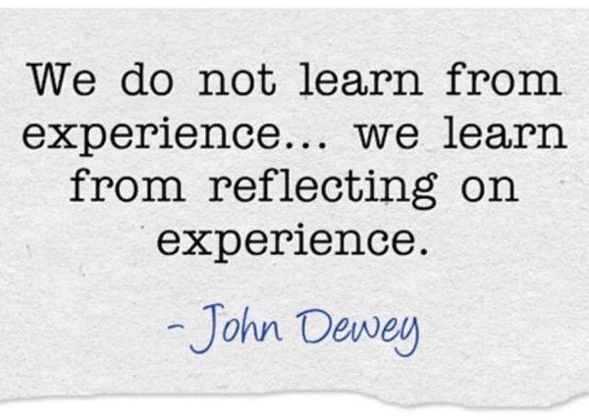
Learning Strategy of the Week: Why reflect?
It is really important to reflect or think about what we have done/are doing so we can improve moving forward

Slide 6
Learning Strategy of the Week: Why reflect?

Slide 7
Learning Strategy of the Week: Reflection

Slide 8
Learning Strategy of the Week: Why reflect?
It is really important to reflect or think about what we have done/are doing so we can improve moving forward

Slide 9
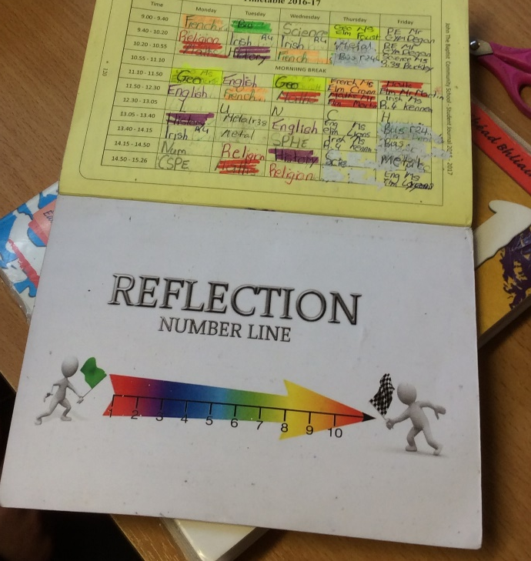
Learning Strategy of the Week: Reflection Arrow
In the school, we reflect using our reflection arrow/reflection number line.
You will see this on walls and in your student journal

Slide 10
Learning Strategy of the Week: Reflection Arrow
How to use it:
Look at the arrow
Think about your learning/understanding of a topic
Place yourself on the line: 1 being totally lost – 10 totally comfortable understanding the topic completely

Slide 11
Learning Strategy of the Week: Reflection Arrow
How to use it (continued):
Think about what you need to do to move up one place in the line: Get help? Ask a question? Learn some keywords? Do some research? Add to an answer? Read more information? Work in a group? Try a new way of presenting the information (e.g. mindmap, graphic etc.)?
If you are at 10, what can you do next time to help you understand the next topic as well as you understand this topic?

Slide 12
Learning Strategy of the Week: Reflection Arrow
Great for:
Helping you reflect on your learning
Figuring out how to improve your learning – just think about one step forward, one way to improve
Improving our numeracy skills

Slide 13
Learning Strategy of the Week: Reflection Arrow
Can be used for:
Learning levels
Readiness to learn – how willing am I to learn today?
My wellbeing – how am I today?

Slide 14
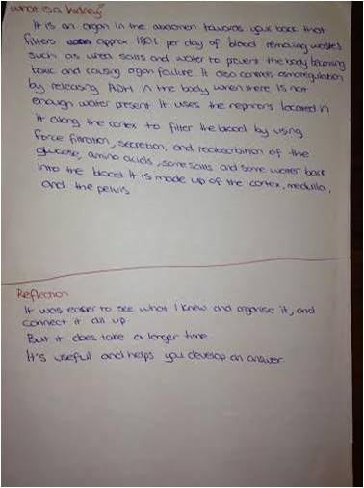
Learning Strategy of the Week: Reflection Arrow
Reflection in Tech. Graphics
Reflection in Biology

Slide 15
Learning Strategy of the Week: Reflection Arrow
Think about using the reflection arrow…
Where would you place your use of it? 1 – very little, 10 – all the time?
Where can I use it in the coming days?

Slide 17
