Slide 1
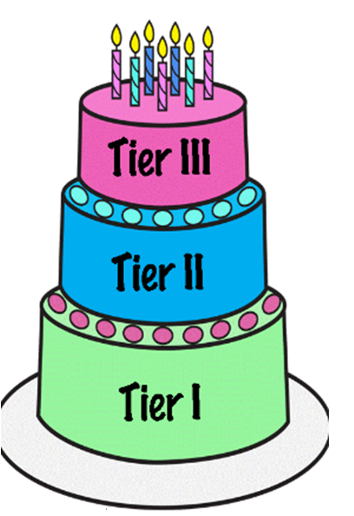
Learning Strategy of the Week: Two Tier Words

Slide 2
Learning Strategy of the Week: Two Tier Words
In life, we meet many different words.
One way we can look at words is to think about them as different tiers depending on how difficult they are or how they are used...

Slide 3
Learning Strategy of the Week: Two Tier Words
Tier 3 | Specific, more difficult words – linked to a specific subject EXPERT WORDS
Tier 2 | More complicated, useful words EDUATED WORDS
Tier 1 | Every day words, simple and basic EVERYDAY WORDS

Slide 4
Learning Strategy of the Week: Two Tier Words

Slide 5
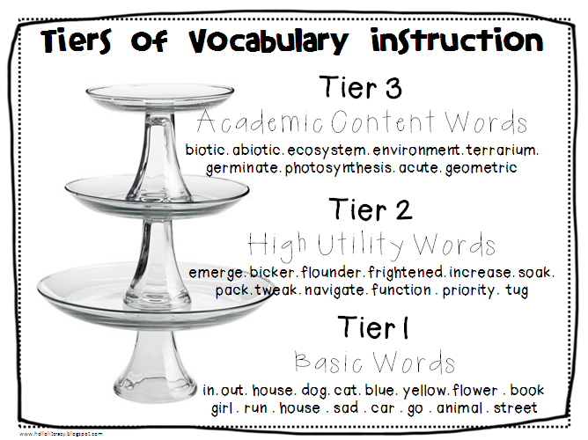
Learning Strategy of the Week: Two Tier Words

Slide 6
Learning Strategy of the Week: Two tier words
How to use it:
Look at the words/vocab you are using – could you add a tier two word?
Great for:
Helping you to understand a text
Breaking down the type of words you use
Improving your writing/reading

Slide 7
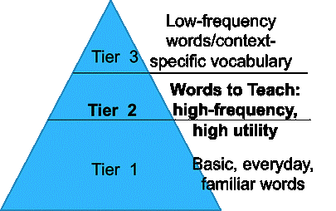
Learning Strategy of the Week: Two Tier Words

Slide 8
Learning Strategy of the Week: Two Tier Words

Slide 9
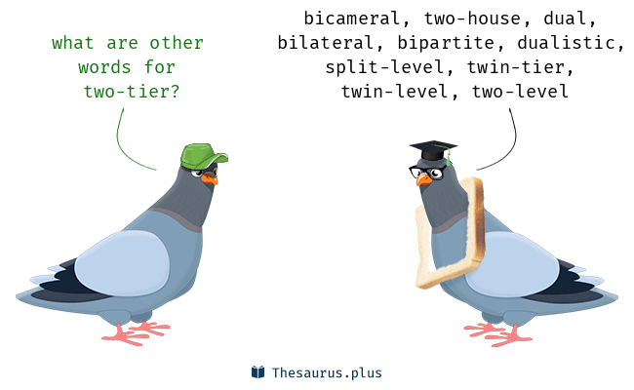
Learning Strategy of the Week: Two Tier Words

Slide 11
